Slide 1
The Past, Present, and Future of Offshore Wind
Sabin Center for Climate Change Law Webinar
Bryan Stockton
Head of Regulatory Affairs

Slide 2
Ørsted Offshore North America portfolio
Awarded over 4,000 MW of offshore capacity on the East coast
In Operation
  Block Island Wind Farm: 30MW
Awarded
  Revolution Wind: 50/50 JV w/ Eversource, 704MW (400MW to RI, 304MW to CT)
  South Fork Wind: 50/50 JV w/ Eversource, 132MW
  Sunrise Wind: 50/50 JV w/ Eversource, approximately 924MW
  Ocean Wind 1: 75/25 JV with PSEG, 1,100MW
  Ocean Wind 2: 1,148MW
  Skipjack Wind 1: 120MW

Slide 3
Current offshore wind projects
U.S. East Coast
Project | Company
Revolution Wind | Ørsted & Eversource
South Fork Wind | Ørsted & Eversource
Sunrise Wind | Ørsted & Eversource
Vineyard Wind 1 | Avangrid Renewables (Iberdrola), CIP
Park City Wind | Avangrid Renewables (Iberdrola)
Mayflower Wind | Shell, EDPR, ENGIE
Empire Wind 1 | BP, Equinor
Empire Wind 2 | BP, Equinor
Atlantic Shores Offshore Wind | Shell, EDFR
Ocean Wind 1 | Ørsted & PSEG
Ocean Wind 2 | Ørsted
Skipjack Wind 1 | Ørsted
Skipjack Wind 2 | Ørsted
MarWin | US Wind Inc.
Coastal Virginia Offshore Wind | Dominion Energy
Kitty Hawk | Avangrid
NY
MA
CT
RI
Revolution Wind 704 MW
Bay State Wind
South Fork Wind 132 MW
Vineyard Wind 1 800 MW
Sunrise Wind ~924 MW
Beacon Wind 1,230 MW
Mayflower Wind 804 MW
Park City Wind 804 MW
Vineyard Wind
NJ
Empire Wind 1 816 MW
Empire Wind 2 1,260 MW
MD
Atlantic Shores Offshore Wind 1,510 MW
Ocean Wind 1 1,100 MW
Ocean Wind 2 1,148 MW
DE
Garden State Offshore Energy
Skipjack Wind 2
Skipjack Wind 1 120 MW
MarWin 269 MW
V
A
Coastal Virginia Offshore Wind 12 MW
Unnamed Dominion Energy Project 2,640 MW
Kitty Hawk 800 MW
Awarded Ørsted project
Ørsted project in development
Source: Ørsted Internal
Based on Public Data and Internal data as of August 2021
Capacity table based on announced, public COD target dates
Industry projects

Slide 4
Over the past decade, scale and continuous innovation have driven down the cost of offshore wind
Key cost reduction levers
Larger sites
Larger turbines
Cost reduction across all components
Shorter installation cycles
Lower operations and maintenance costs
More competitive supply chain

Slide 5
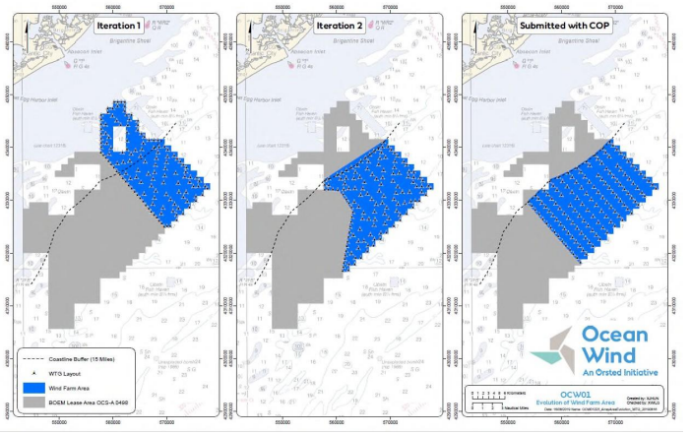
Evolution of project area and proposed layouts
Ocean Wind example
  Self imposed setback (visual)
  Shift to grid layout rather than wind-optimized design (navigation)

Slide 6
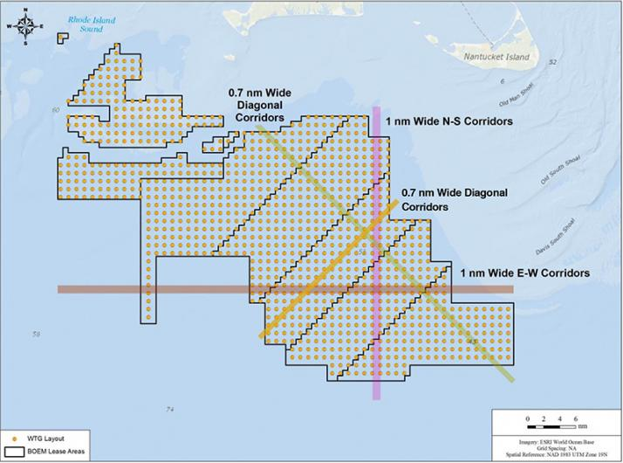
NEPA alternatives (cont.)

Slide 7
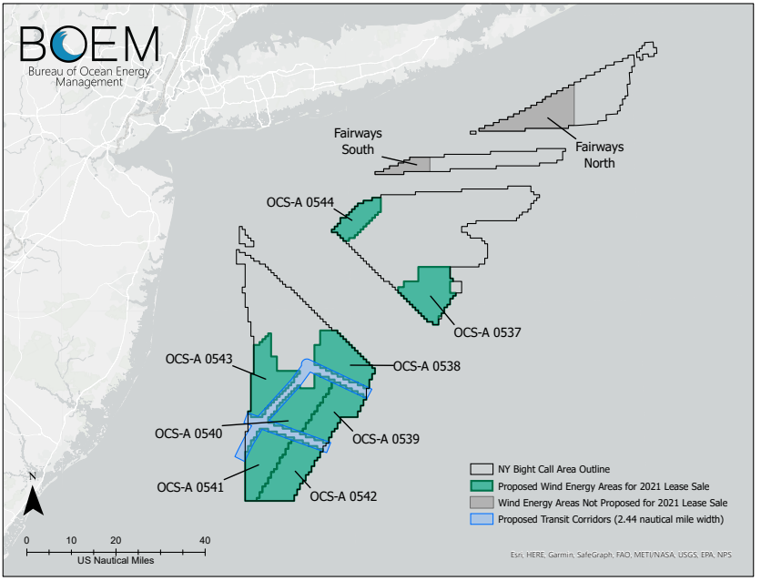
New York Bight

Slide 8
Thank you
Bryan Stockton
Head of Regulatory Affairs
BRSTO@orsted.com

